Slide 1

Group 20
Comprehensive Database Management System for Stone Crushing Operations
5 December 2024

Slide 2



Agenda
EER & UML & Relational Modeling
Problem Statement
SQL & NoSQL Implementation
Challenges and inefficiencies in current data management practices.
Visual representations of the database structure and relationships.
Technical details and considerations for data storage and retrieval.

Slide 3
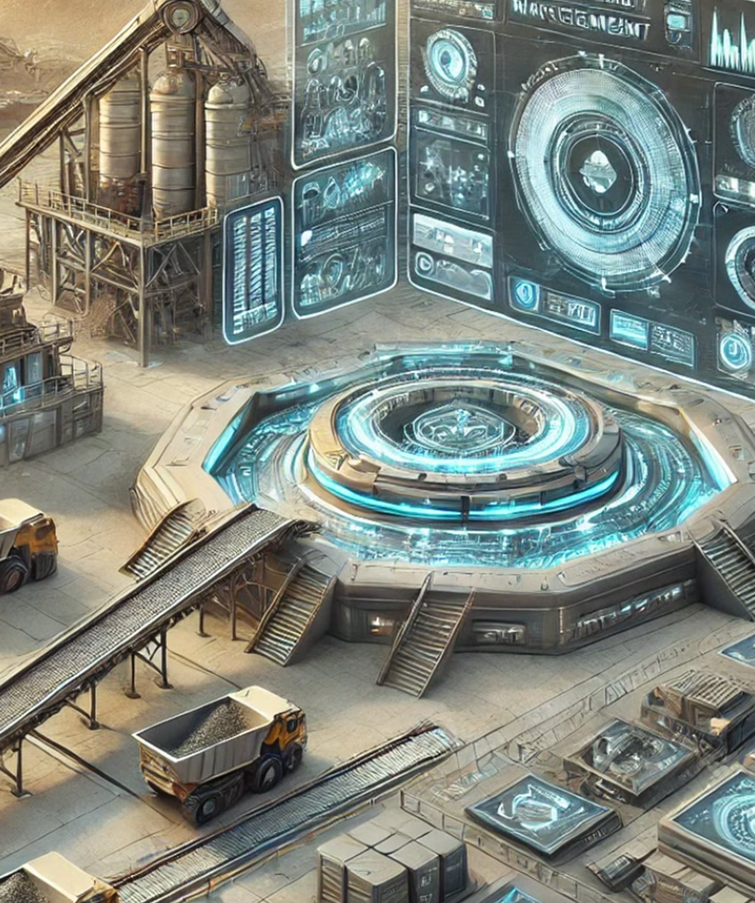
Problem Statement
The mining and stone crushing industry involves complex operations, including machinery monitoring, inventory management, workforce coordination, and sales tracking, all of which are interdependent.
•Traditional bookkeeping methods are inefficient and
prone to errors, making it challenging to manage these
aspects effectively.
•Implementing a centralized database management
system can streamline operations, reduce costs, and
improve overall efficiency, ensuring competitiveness in
the industry.

Slide 4
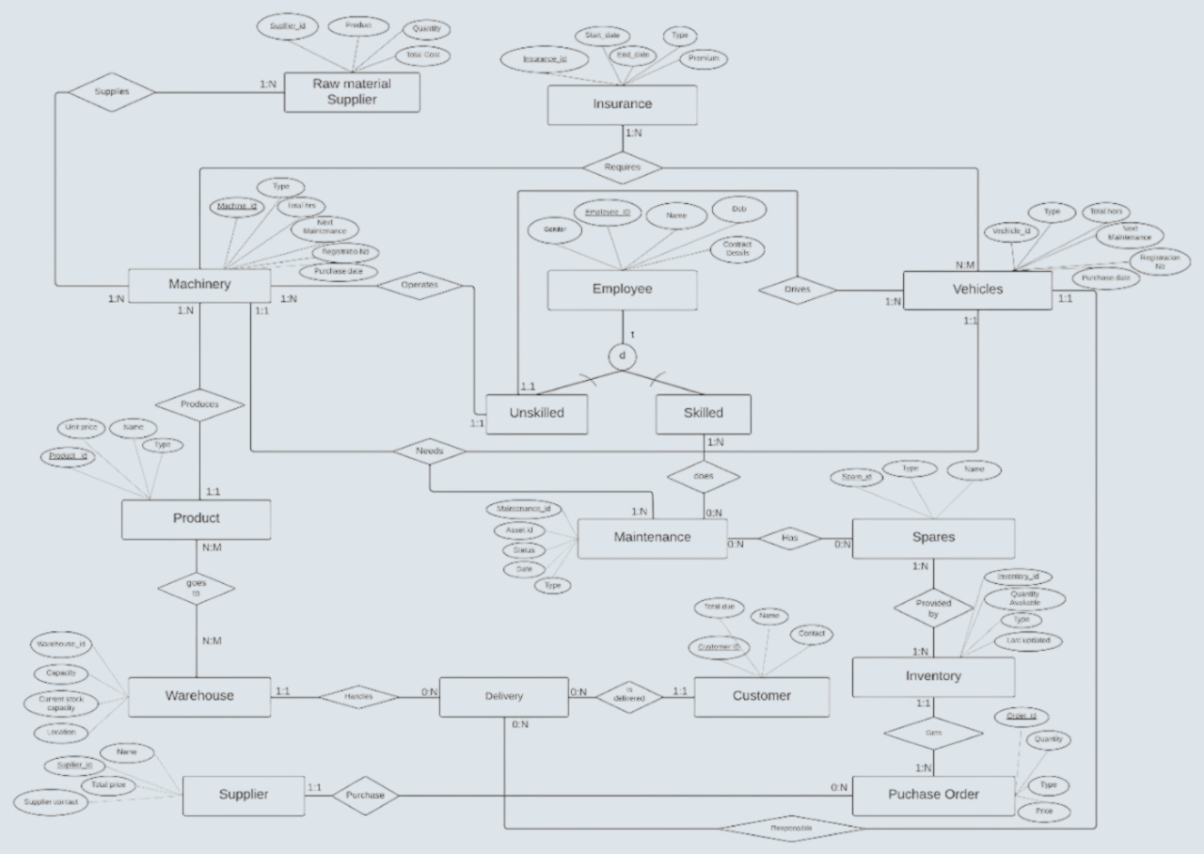
EER Diagram

Slide 5
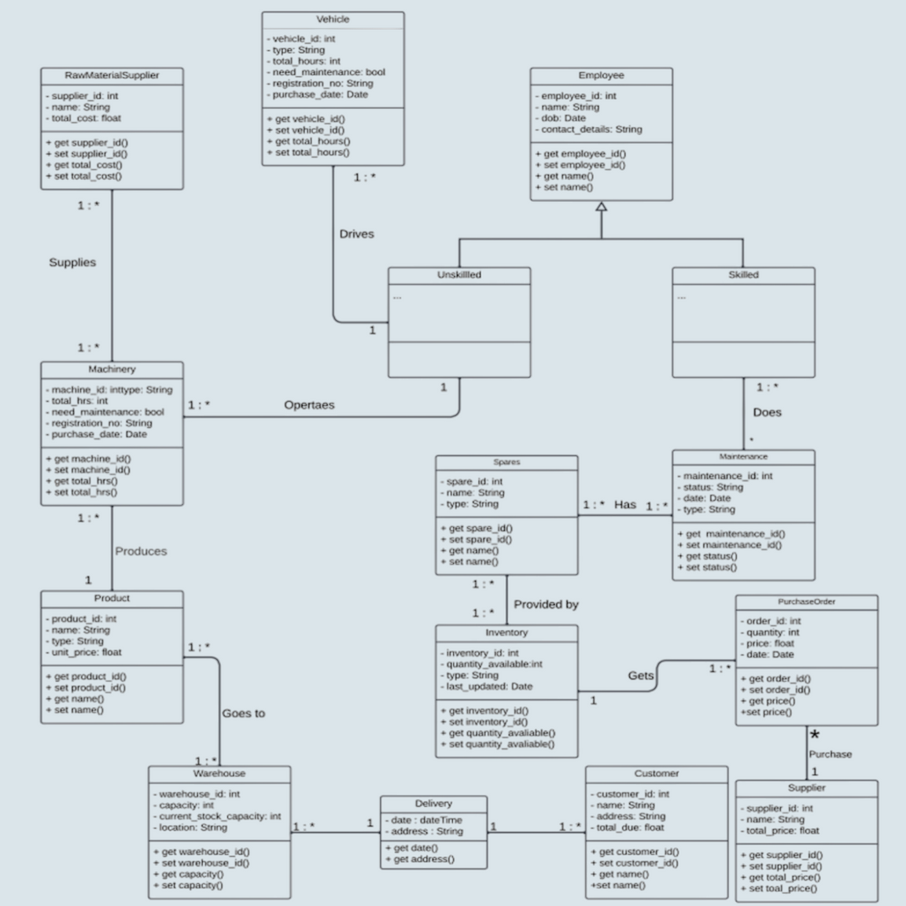
UML Diagram

Slide 6

RawMaterialSupplier
SupplierID – (PK, Not Null)
Product
Quantity
TotalCost
Insurance
InsuranceID – (PK, Not Null)
StartDate
EndDate
Type
Premium
Employee
EmployeeID – (PK, Not Null)
Gender
Name
DateOfBirth
ContactDetails
SkillType
Relational Model

Slide 7

Machinery
MachineryID (PK, Not Null)
Type
LastMaintenance
Employee_Incharge (FK, Not Null) – References EmployeeId from employee metrics
InsuranceId (FK, Not Null) - References InsuranceId from insurance metrics
Vehicles
VehicleID - (PK, Not null)
Type
PurchaseDate
Employee_Incharge (FK, Not Null) - References EmployeeId from employee metrics
InsuranceId (FK, Not Null) - References InsuranceId from insurance metrics
Product
ProductID – (PK, Not Null)
UnitPrice
Name
Type
Relational Model

Slide 8
Warehouse
WarehouseID (PK, Not Null)
Capacity
CurrentStock
Location
Product (FK, Not Null) - References ProductId from product metrics
PurchaseOrder
OrderID (PK, Not Null)
OrderInventoryId (FK, Not Null) - ReferencesInventoryId from inventory metrics
SpareID (FK, Not Null) - References SpareId from spares metrics
Quantity
Relational Model

Slide 9
Spares
SpareID – (PK, Not Null)
Type
Name
Stock
Cost
Delivery
DeliveryID (PK, Not Null)
ProductID (FK, Not Null) - References ProductId in product metric
CustomerID (Not Null) - References CustomerId in customer metric
Date
Address
Relational Model

Slide 10

Data Set
The dataset has been generated using personal knowledge and experience, complemented by data from Google Scholar. It has been meticulously refined and tailored to align with the objectives and requirements of the project.

Slide 11
Queries
SQL
NoSQL
Python
Simple
Aggregated
Join
Nested
Correlated
All / Any
Exists
Set Operation
Subqueries in select
Subqueries in from
Simple
Aggreated
Complex
Scatter Plot
Bar Chart
Pie Chart

Slide 12
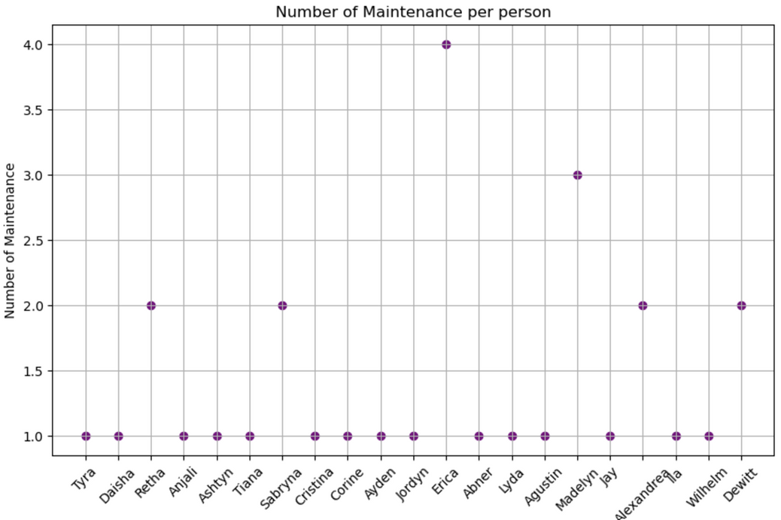
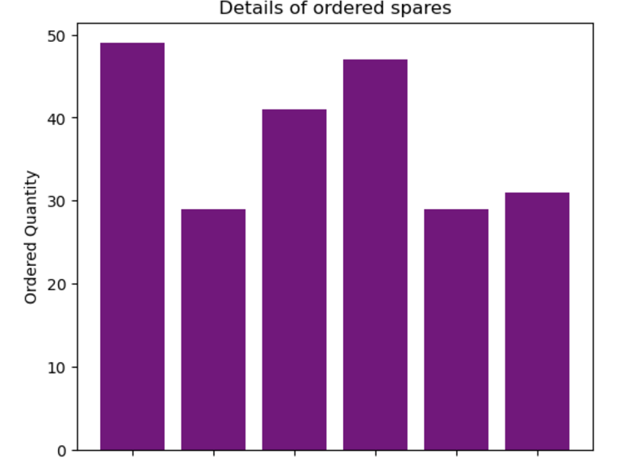
Python to DB Connection
The Python-to-Database connection is effectively implemented and proves highly useful for creating various types of visualization charts based on the data from the database.

Slide 13
Next Step
Enhanced Data Integration and Real-Time Analytics
Predictive Modeling and Data Analysis
Interactive Dashboards

Slide 14
Thank you

